Slide 1

Database Management Systems
Shamim Ahmad

Slide 2
Data Definition Language (DDL)

Slide 3
Data Definition Language (DDL)
Specification notation for defining the database schema
E.g. create table account ( account-number char(10), balance integer)
DDL compiler generates a set of tables stored in a data dictionary
Data dictionary contains metadata (i.e., data about data)
database schema
Data storage and definition language
language in which the storage structure and access methods used by the database system are specified
Usually an extension of the data definition language

Slide 4
Data Manipulation Language (DML)

Slide 5
Data Manipulation Language (DML)
Language for accessing and manipulating the data organized by the appropriate data model
DML also known as query language
Two classes of languages
Procedural – user specifies what data is required and how to get those data
Nonprocedural – user specifies what data is required without specifying how to get those data
SQL is the most widely used query language

Slide 6


Slide 7
Type | Description | Example Values
INT | Integer (whole number) | 1, 42, -100
TINYINT | Very small integer (-128 to 127) | 0, 127
SMALLINT | Small integer | -32,768 to 32,767
MEDIUMINT | Medium integer | -8M to 8M approx.
BIGINT | Large integer | -2⁶³ to 2⁶³-1
DECIMAL(p,s) | Fixed-point number (precision, scale) | DECIMAL(5,2): 123.45
FLOAT | Single-precision floating point | 3.14
DOUBLE | Double-precision floating point | 3.14159265359
BIT | Stores bit-field values | BIT(1) = 0 or 1
BOOLEAN | Alias for TINYINT(1) (0 = false, 1 = true) | 0, 1

Slide 8
Type | Description | Example
DATE | Date (YYYY-MM-DD) | '2025-08-02'
DATETIME | Date and time | '2025-08-02 13:45:00'
TIMESTAMP | Date and time (with auto update) | '2025-08-02 13:45:00'
TIME | Time only | '13:45:00'
YEAR | Year (4 digits) | 2025

Slide 9
Type | Description | Example
CHAR(n) | Fixed-length string (padded) | 'Hello '
VARCHAR(n) | Variable-length string | 'Hello'
TEXT | Large text (up to 64 KB) | Article, paragraph
TINYTEXT | Up to 255 characters | Short description
MEDIUMTEXT | Up to 16 MB | Medium documents
LONGTEXT | Up to 4 GB | Books, large logs
ENUM(...) | One value from a list | 'Male', 'Female'
SET(...) | Multiple values from a list | 'Reading, Swimming'
BLOB types | Binary data (e.g., images/files) | Binary files

Slide 10
CREATE DATABASE university;
CREATE TABLE students (
student_id INT AUTO_INCREMENT PRIMARY KEY,
name VARCHAR(100),
birth_date DATE,
email VARCHAR(100) UNIQUE,
gpa DECIMAL(3,2)
);

Slide 11
Add a new column
ALTER TABLE students ADD COLUMN phone VARCHAR(15);
Modify a column
ALTER TABLE students MODIFY COLUMN gpa DECIMAL(4,2);
Drop a column
ALTER TABLE students DROP COLUMN phone;

Slide 12
SQL
SQL: widely used non-procedural language
E.g. find the name of the customer with customer-id 192-83-7465 select customer.customer-name from customer where customer.customer-id = ‘192-83-7465’
E.g. find the balances of all accounts held by the customer with customer-id 192-83-7465 select account.balance from depositor, account where depositor.customer-id = ‘192-83-7465’ and depositor.account-number = account.account-number
Application programs generally access databases through one of
Language extensions to allow embedded SQL
Application program interface (e.g. ODBC/JDBC) which allow SQL queries to be sent to a database

Slide 14
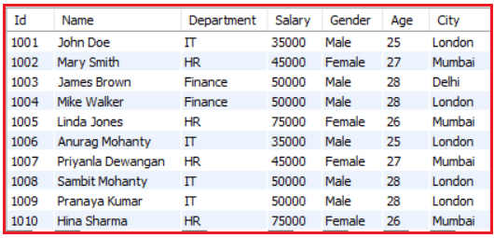

Slide 15
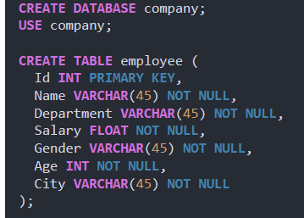

Slide 16
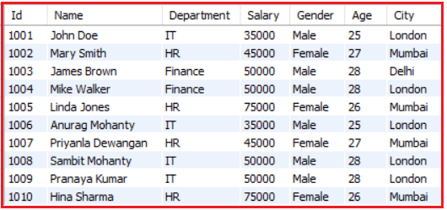

Slide 17
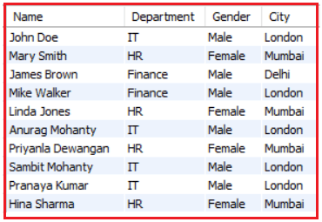
SELECT Name, Department, Gender, City FROM employee;

Slide 18
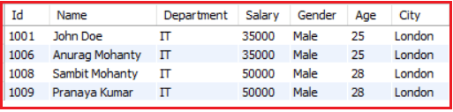
SELECT * FROM employee WHERE Department = ‘IT’;
SELECT Id, Name, Department, Salary, Gender, Age, City FROM employee;

